Slide 1
Data Structures and Algorithms -3 (25CS2103E)
Optimal Binary Search Tree for Efficient Search Optimization
Team Members
2520030518 - P. Naveen
2520030386 - T. Jashwanth
2520030475 - E. Ashwith
Under the Esteemed Guidance of
Mrs. J. Yamini Devi
Assistant Professor

Slide 2
Contents
Abstract
Introduction
Literature survey
Problem Statement and Objectives
Hardware and Software requirements
Results
Conclusion
Future Scope

Slide 3
Abstract
The Optimal Binary Search Tree (OBST) project aims to develop an application that constructs an efficient Binary Search Tree using a given set of keys and their search frequencies. The primary objective is to minimize the average search cost by arranging the keys in an optimal order. Unlike a standard Binary Search Tree, an Optimal Binary Search Tree considers how frequently each key is accessed, ensuring that frequently searched keys are placed closer to the root, thereby reducing the overall search time.
The application accepts a list of sorted keys along with their corresponding search frequencies as input. It then applies the Dynamic Programming technique to determine the optimal tree structure that yields the minimum expected search cost. After computation, the system displays the resulting Optimal Binary Search Tree and calculates the expected search cost, allowing users to understand the efficiency gained through optimization.
This project demonstrates the practical application of interval dynamic programming in solving optimization problems and highlights the importance of algorithm design in improving search performance. It provides an educational platform for students to understand dynamic programming concepts, binary search trees, and cost optimization techniques. The system is suitable for academic learning and can serve as a foundation for advanced search optimization applications in databases, compilers, and information retrieval systems.

Slide 4
Introduction
The Problem: Standard BSTs are built based on insertion order or balancing, but they ignore how often a key is searched.​
Example: If "Apple" is searched 1000 times and "Zebra" 1 time, a balanced BST might put "Zebra" near the root—making frequent searches slow!​
The OBST Solution: Uses search frequencies to reorder keys. High- frequency keys are moved closer to the root, drastically reducing average lookup time.
​Core Concept: We don't need the shortest tree; we need the cheapest tree in terms of weighted path length (Frequency × Depth). This is a classic optimization problem solved using Interval Dynamic Programming.​

Slide 5
Literature Survey
Author / Work | Key Contribution | Relevance to Our Project
Knuth, D.E. (1971) | Introduced the dynamic programming algorithm for OBST and proved optimal substructure. | Foundation of our recurrence relation and root table logic.
Cormen et al. (CLRS) | Formalized OBST in standard textbooks; detailed recurrence and pseudo-code. | Used for defining cost tables C[i][j] and summing frequencies.
Gilbert & Moore (1959) | Early work on alphabetic binary trees (precursor to OBST). | Historical basis for ordered key search optimization.
AVL / Red-Black Trees | Standard self-balancing trees for guaranteed O(log n) height. | Compared against—proving that balancing height is not always optimal when frequencies vary.
Splay Trees | Self-adjusting trees that move accessed nodes to the root. | Modern alternative; we contrast static OBST (built once) with dynamic self-adjustment.

Slide 6
Problem Statement and Objectives
Problem Statement: Given a set of n distinct sorted keys K = {k1, k2, ... , kn} with associated search frequencies F = {f1, f2, ... , f.} , construct a Binary Search Tree that minimizes the Expected Search Cost (Total Cost = E fi x (depth(ki) + 1)).
Objectives:
1. Input Handling: Accept sorted keys and their corresponding integer frequencies.
2. DP Implementation: Apply interval DP to compute the minimal cost for every sub-interval of keys.
3. Root Table Construction: Store the optimal root index for every interval to reconstruct the tree.
4. Tree Visualization: Display the resulting optimal BST structure.
5. Cost Computation: Output the minimum expected search cost.
6. Performance Analysis: Compare DP efficiency (O(n3)) against brute-force (exponential) approaches.

Slide 7
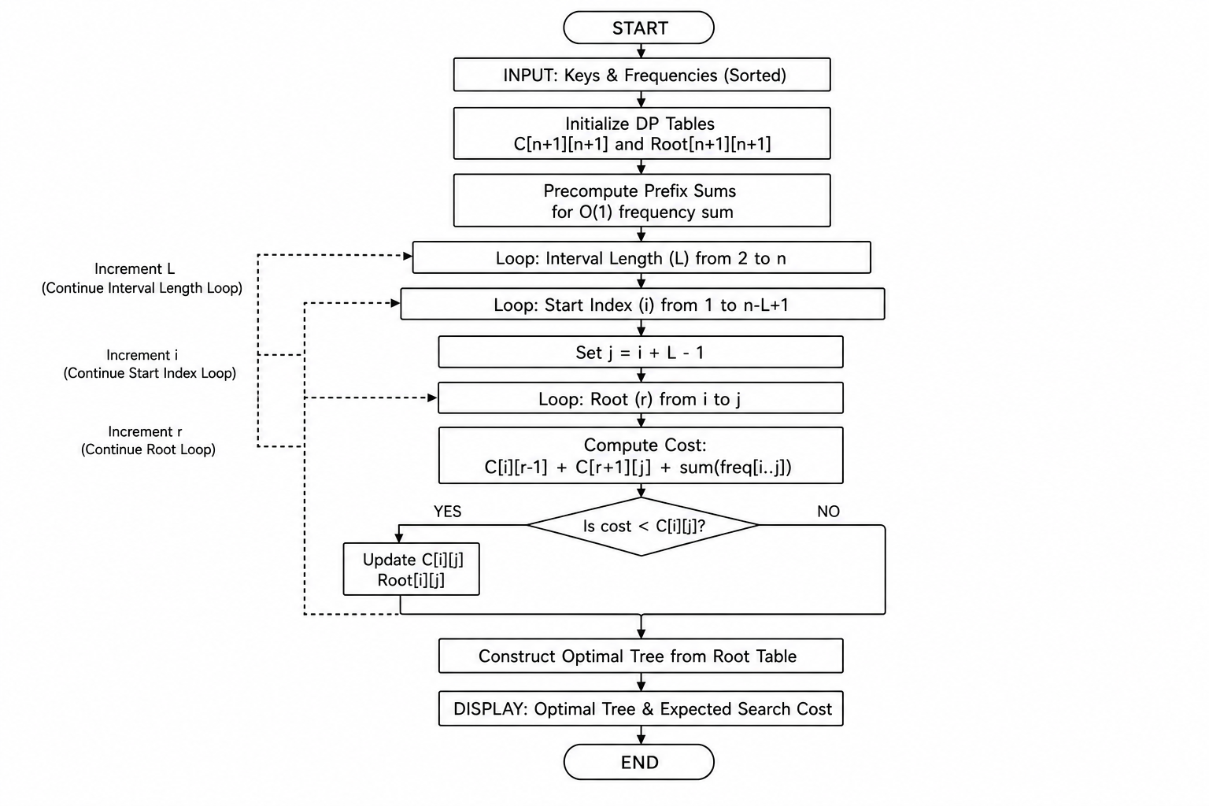
Flow Chart

Slide 8
Results
Test Case:
Keys: {10, 20, 30} Frequencies: {3, 2, 5}
Computed DP Cost Table (C[i][j]):
Optimal Root: Root[1][3] = 2 → Overall root is 20
 | 1 | 2 | 3
1 | 3 | 7 | 18 (Final Answer)
2 | - | 2 | 9
3 | - | - | 5
Resulting Optimal BST Structure:
[20]
/ \
[10] [30]
Expected Search Cost Calculation:
Cost = (Freq of 20 × Depth 0) + (Freq of 10 × Depth 1) + (Freq of 30 × Depth 1)
Cost = (2 × 1) + (3 × 2) + (5 × 2) = 2 + 6 + 10 = 18
Worst-case cost (if root 10): 3×1 + 2×2 + 5×3 = 22.
Improvement: ~18.18% reduction in search cost.

Slide 9
Hardware and Software requirements
Category | Specification
Processor | Intel Core i3 / AMD Ryzen 3 or higher
RAM | Minimum 4 GB (8 GB recommended)
Storage | 100 MB free disk space
OS | Windows 10/11, Linux (Ubuntu 20.04+), or macOS
Language | C++ (using Standard Template Library - STL)
IDE / Compiler | VS Code / Code::Blocks / GCC / JDK (if using Java)
Libraries | iostream, vector, iomanip for console output formatting

Slide 10
Conclusion
Success: We successfully developed an application that constructs an Optimal BST using search frequencies.
DP Implementation: The Interval Dynamic Programming algorithm efficiently computes the minimal expected cost in O(n³) time, avoiding exponential brute-force calculations.
Visualization: The system reconstructs and displays the optimal tree, clearly showing how high-frequency keys are elevated closer to the root.
Educational Value: The project demonstrates critical algorithmic concepts—optimal substructure, overlapping subproblems, and interval DP—crucial for solving real-world search optimization.
Real-world Impact: OBSTs directly improve performance in database indexing, compiler symbol tables, and search engine dictionaries.

Slide 11
Future Scope
Dynamic OBST: Extend the algorithm to support dynamic insertions and deletions (currently static).
Unsuccessful Searches: Add "dummy keys" (failure probabilities) to account for searches that miss the key, using the full Knuth algorithm.
Knuth's Optimization: Implement the O(n²) optimization using monotonicity of roots to handle datasets larger than 10,000 keys.
Graphical User Interface (GUI): Move beyond console output; build a visual UI (e.g., using Java Swing or Python Tkinter) to draw the BST dynamically.
Database Integration: Plug this logic into a real database query optimizer for real-time index selection based on query logs.

Slide 12
Thank you

